Slide 1
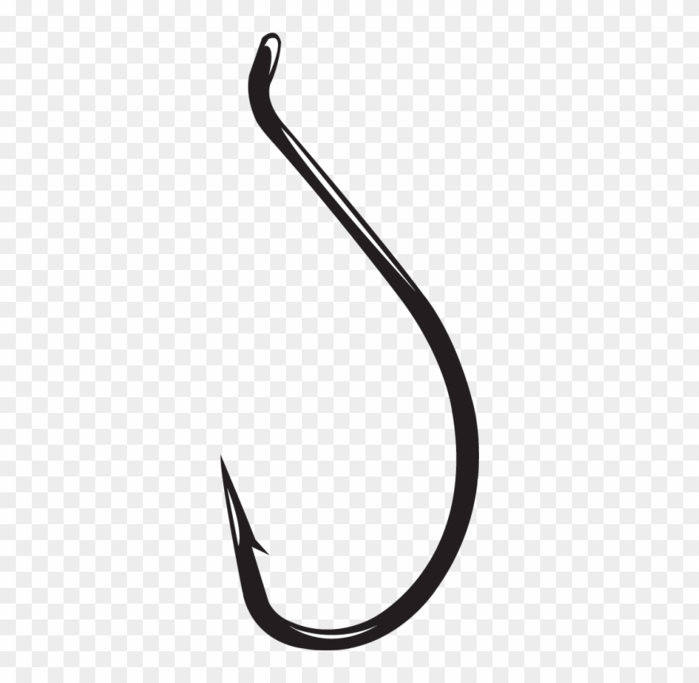
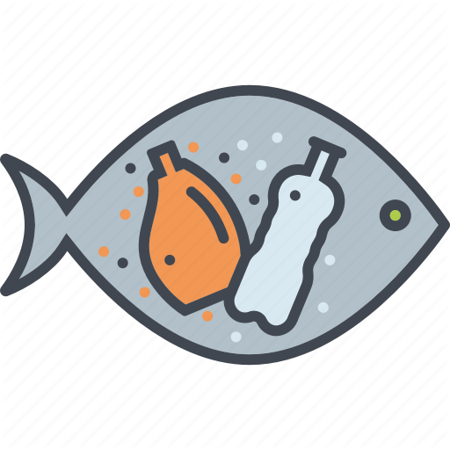
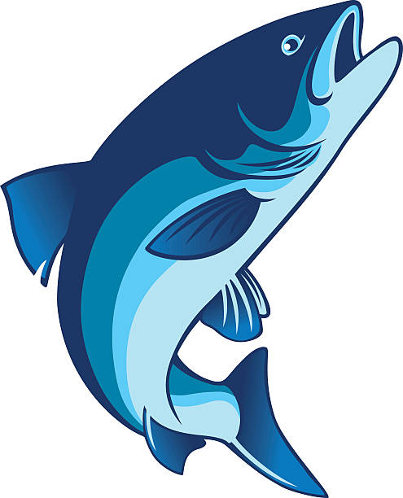
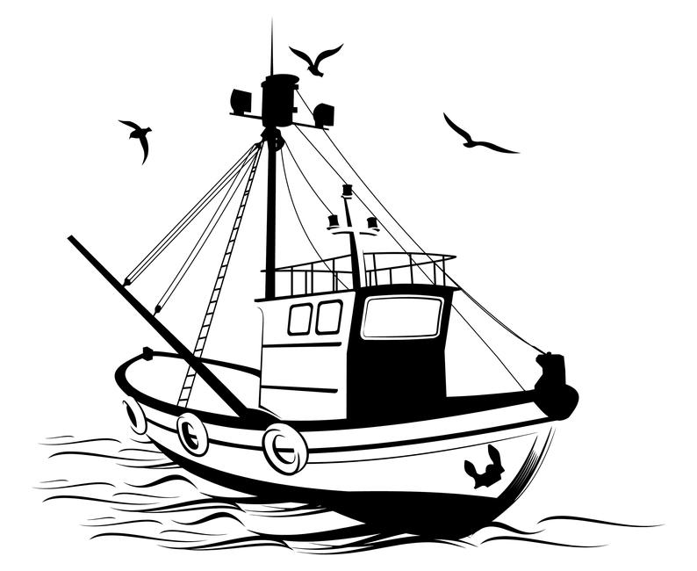
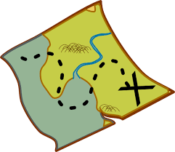
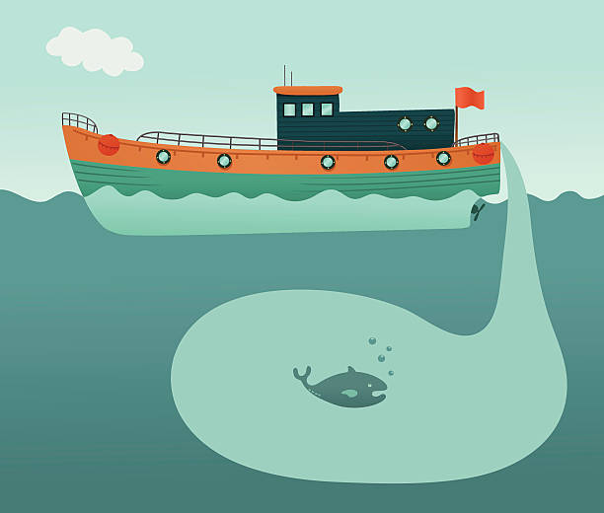
Catching fish …
…but are they good?

Slide 2

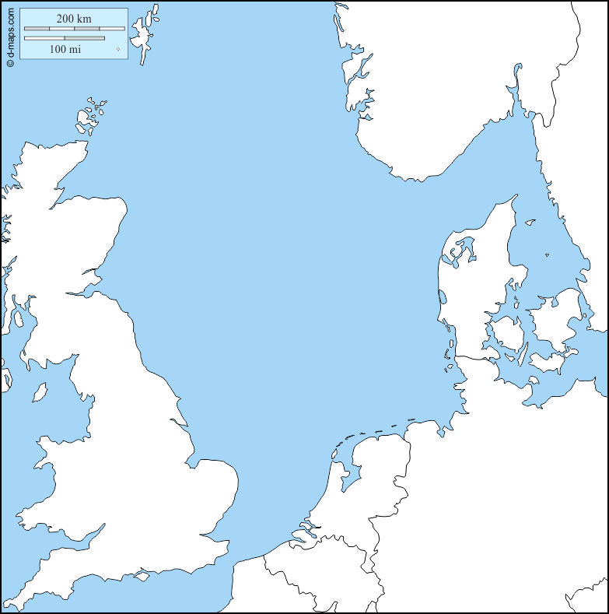
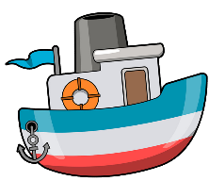
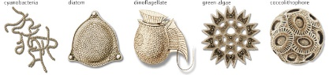
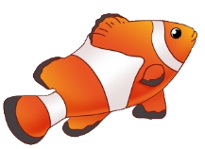
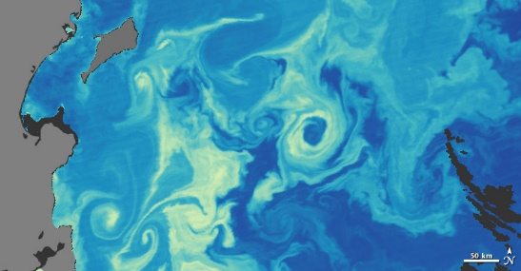
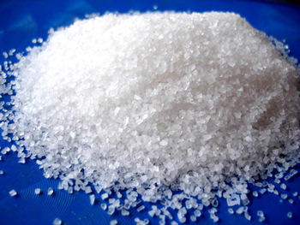
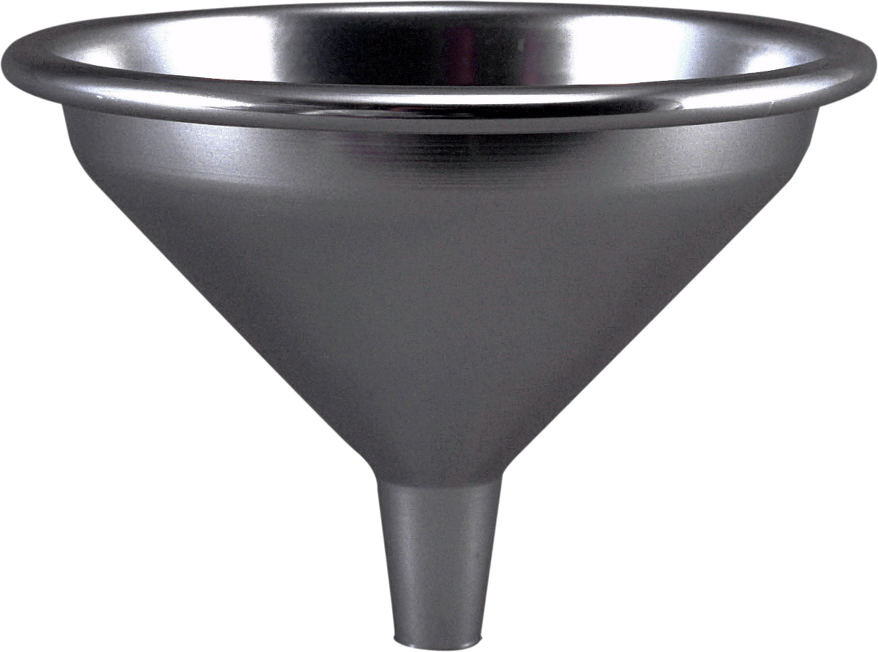
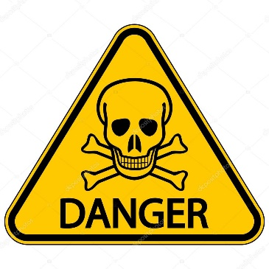

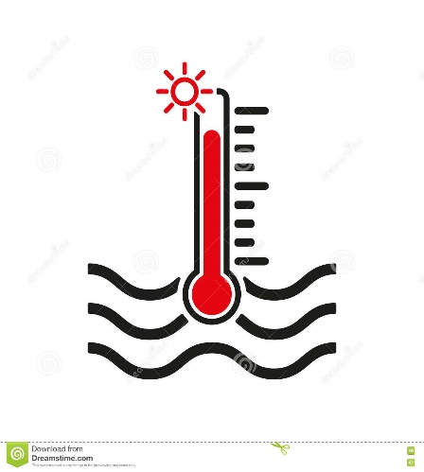
We offer you
Accessible in COPERNICUS
Measurable & estimable in the field
Phytoplankton
Salinity
Contaminants
Waves
Water temperature

Slide 3
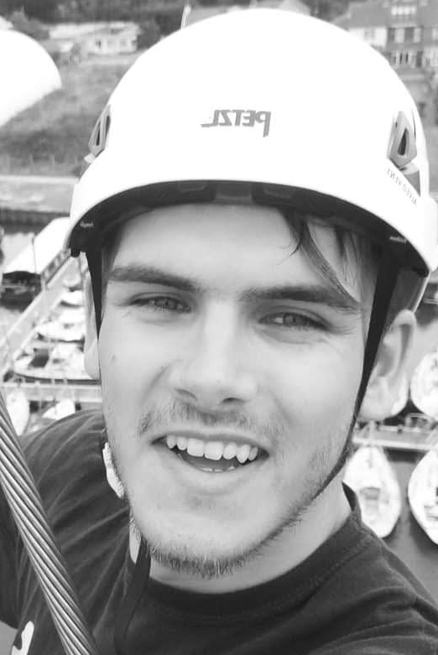
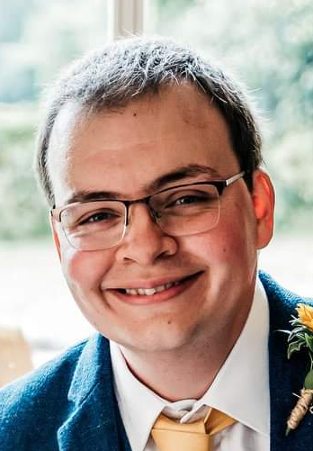
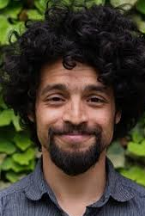
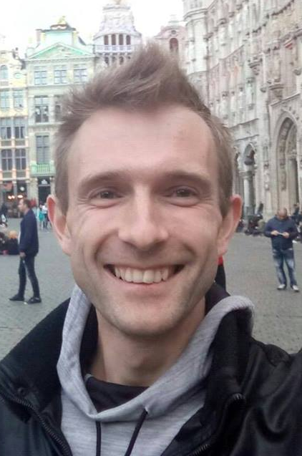
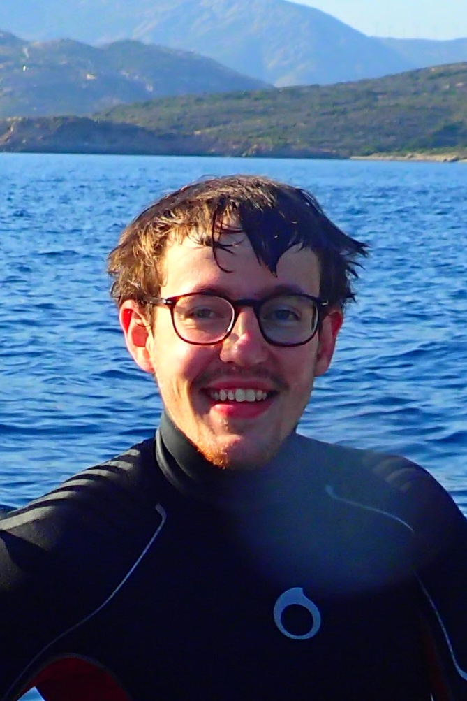
Dream team
Edward Clark
Geophysics
Thomas Gardner
Computer Science
Everardo González Ávalos Engineering Cybernetics
Evgeny Ivanov
Oceanography
Evgeny Ivanov
Marine Biology

Slide 4

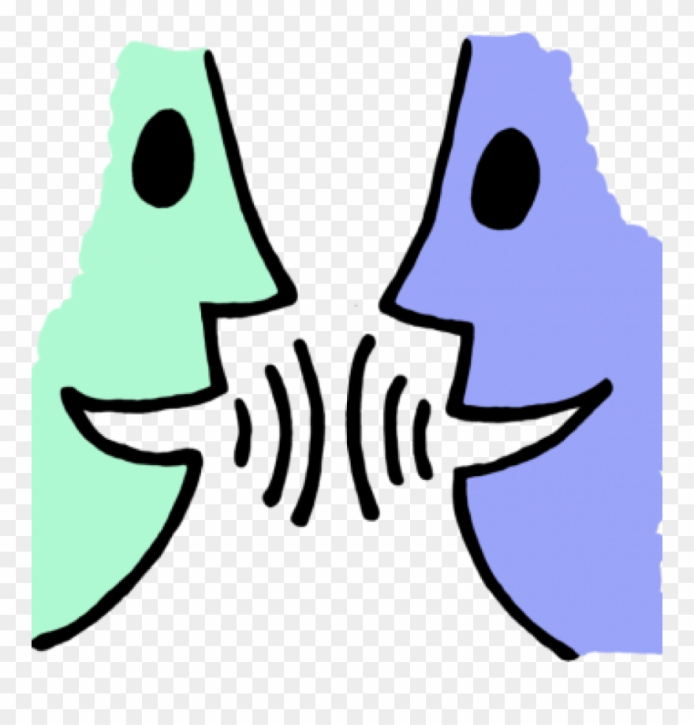
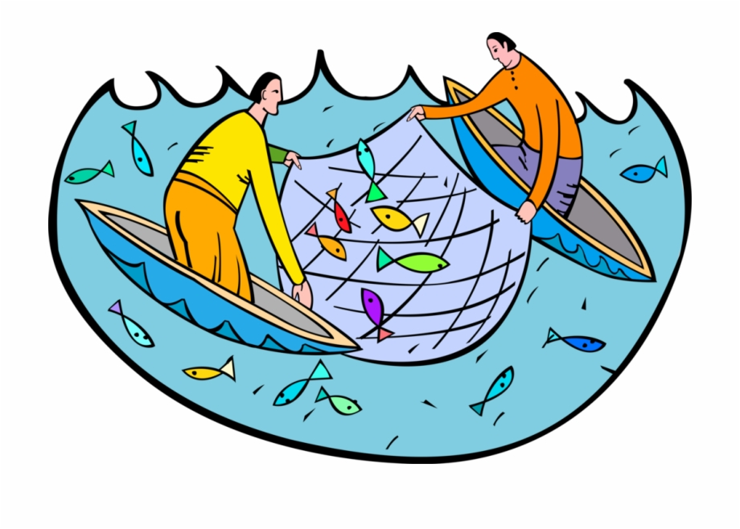
We
We … the ocean wants you
Test
Discuss
Fishermen

Slide 5
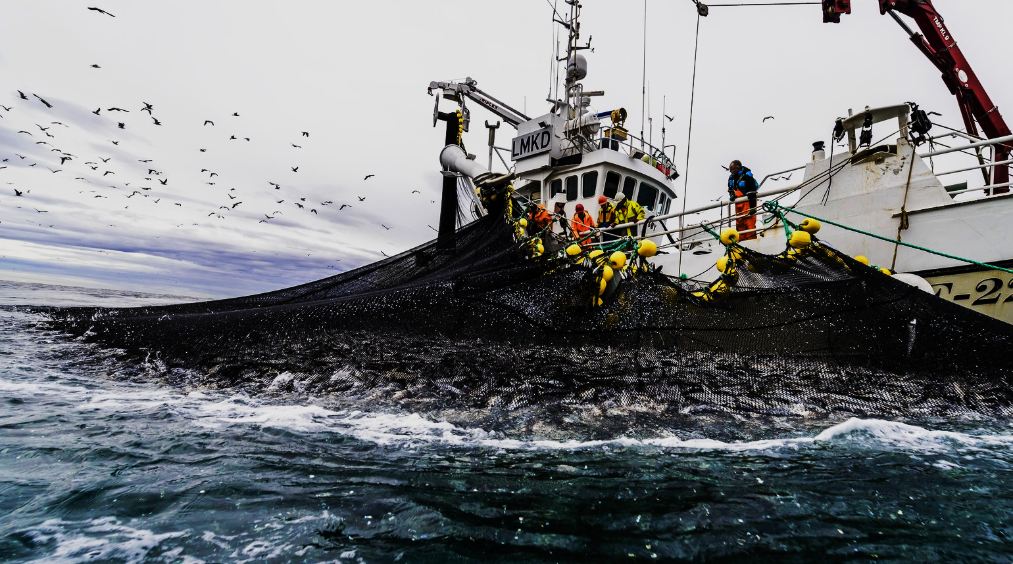

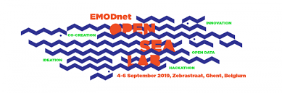
Where not to fish?
A dynamic mapping of sensitive and polluted fishing areas
PyFish team: Edward Clark, Thomas Gardner, Everardo González Ávalos, Evgeny Ivanov and Pierrot Van der Aa

Slide 6






Variables
Phytoplankton
Pollution
Temperature
Danger
Variables
Salinity
Vulnerability
Phytoplankton
Temperature
Salinity
Target
Fishing effort

Slide 7
Thank you for your attention
PyFish team: Edward Clark, Thomas Gardner, Everardo González Ávalos, Evgeny Ivanov and Pierrot Van der Aa

